Slide 1
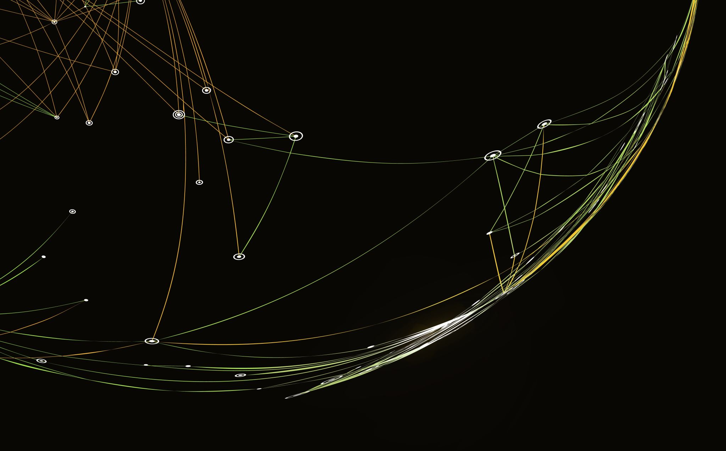

Robot Framework API Automation Environment Setup

Slide 2

Environment Setup
Pre-requisites Required
Python
PyCharm IDE
Install Below listed Libraries using CMD
robotframework
requests
robotframework-requests
robotframework-jsonlibrary

Slide 3
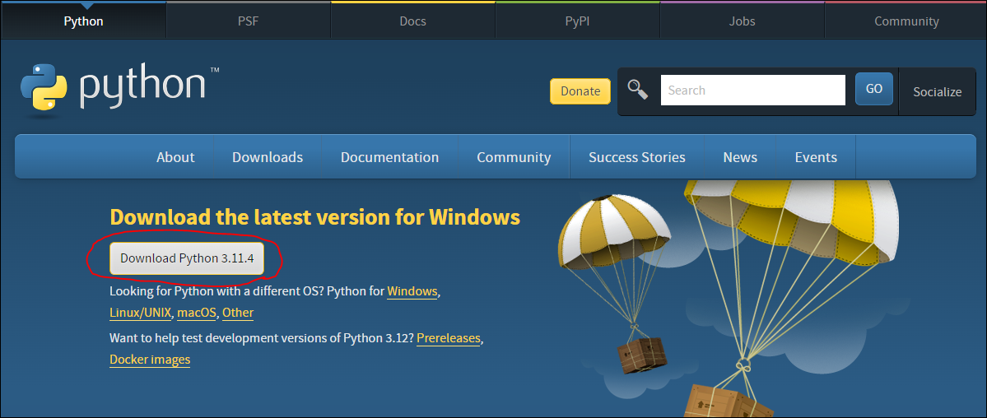
Python Installation for window
https://www.python.org/downloads/

Slide 4
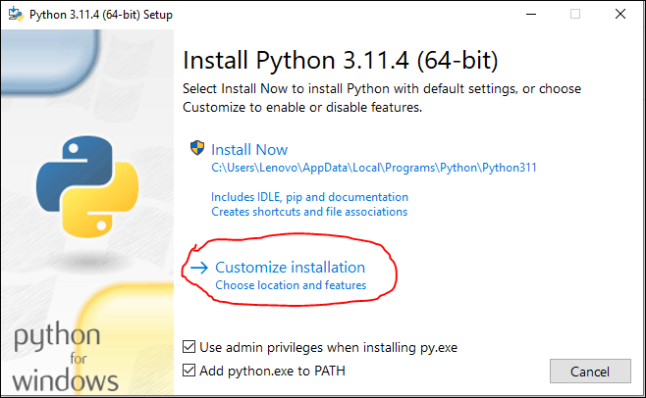

Slide 5
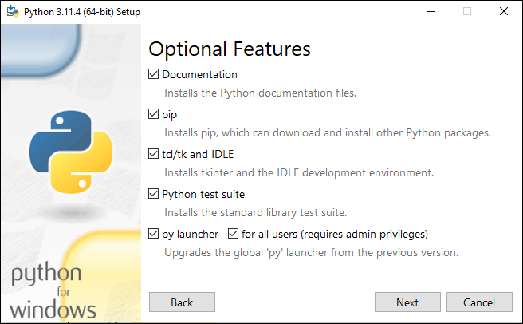

Slide 6
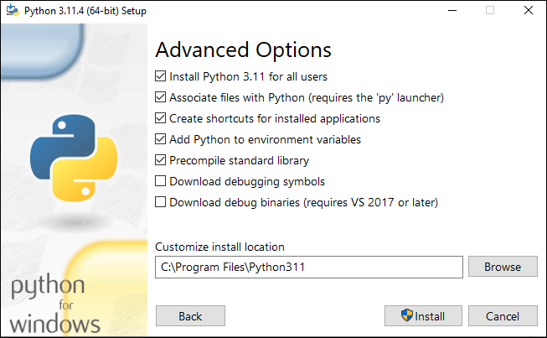

Slide 7
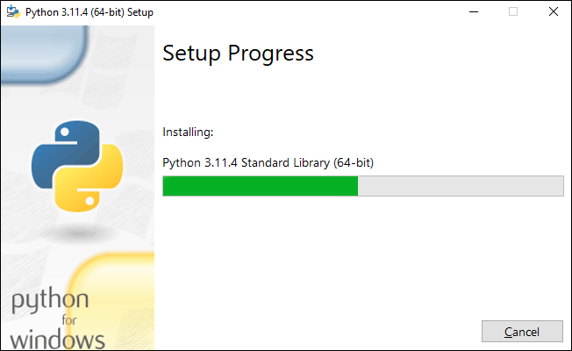
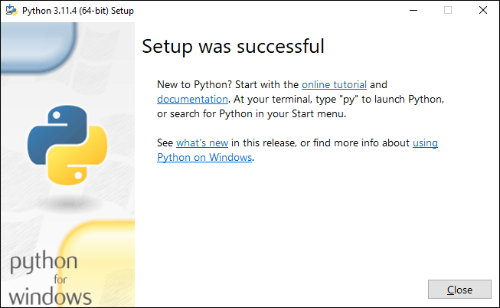

Slide 8
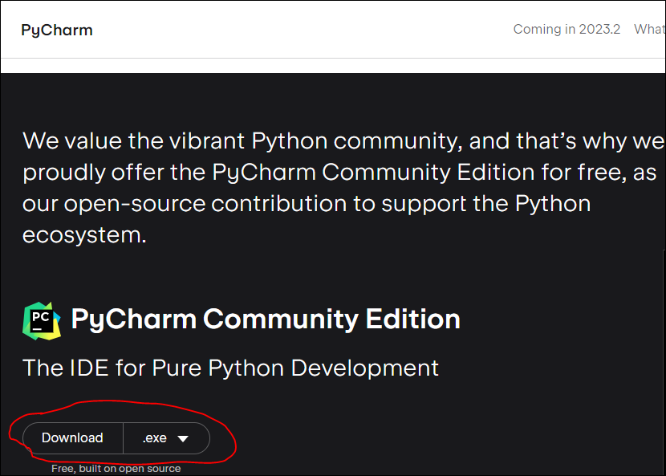
PyCharm IDE Installation
https://www.jetbrains.com/pycharm/download/?section=windows

Slide 9
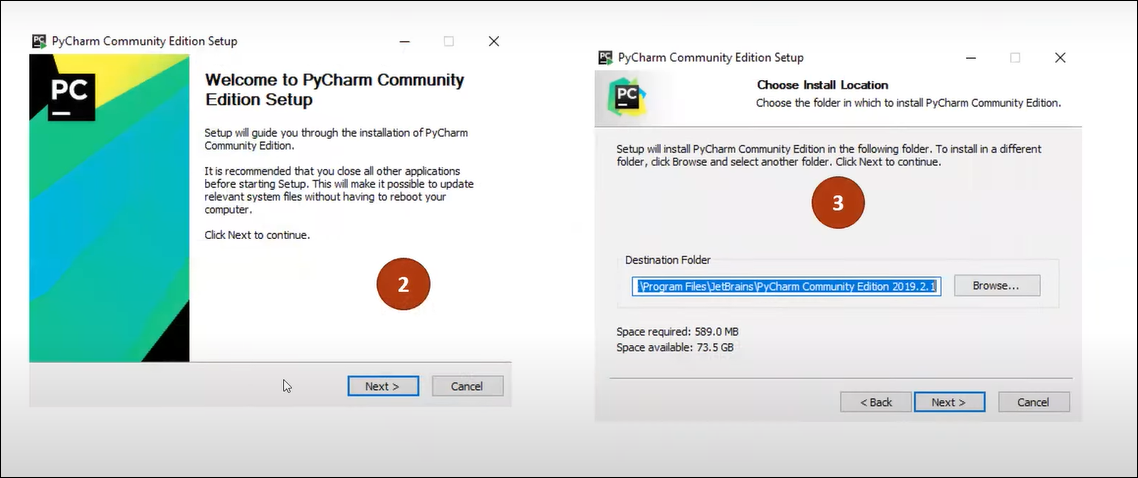

Slide 10
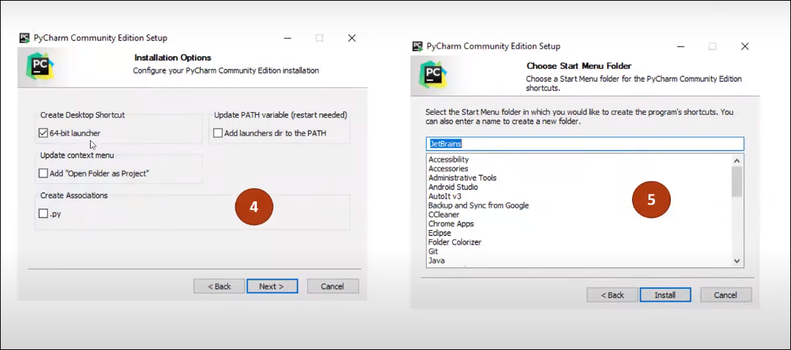

Slide 11
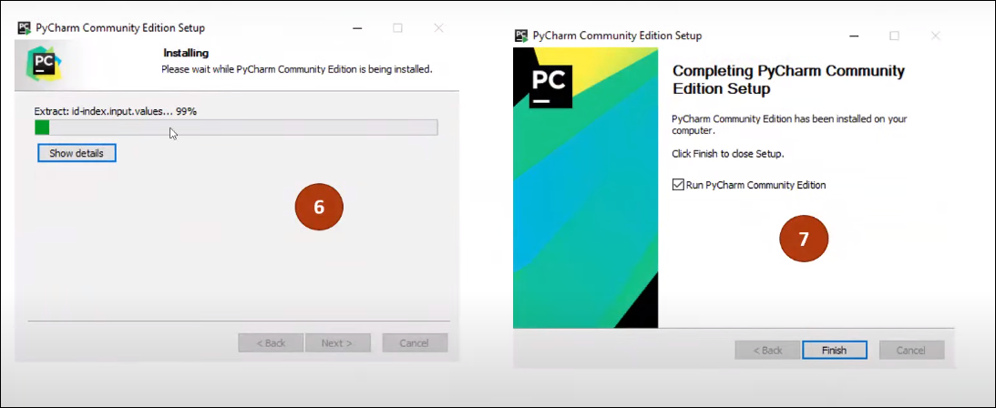

Slide 12
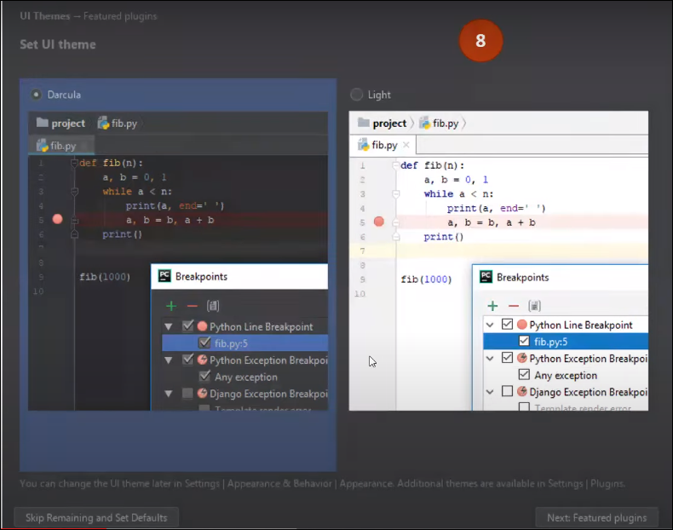

Slide 13
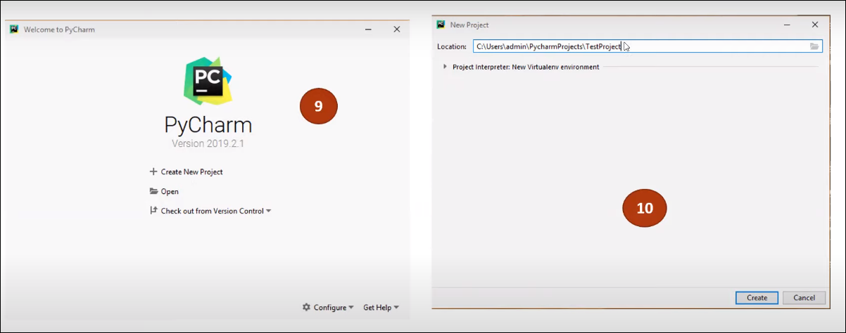

Slide 14


Robot framework libraries installation

Slide 15




Slide 16
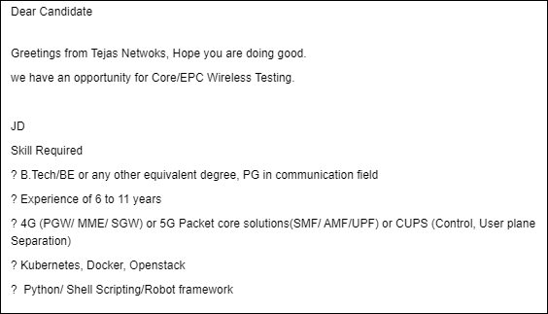

Slide 17
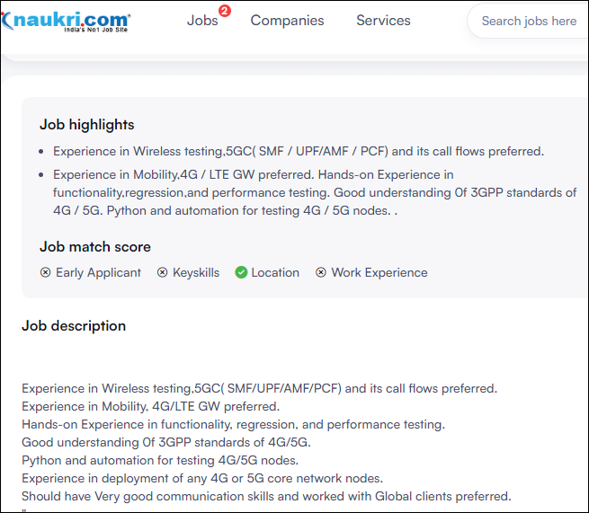

Slide 18
